Slide 1
How To Write Unit Tests
Jason Sylvestre
College of Agricultural & Environmental Sciences
April 15, 2011
Notes:
This template can be used as a starter file for presenting training materials in a group setting.
Sections
Right-click on a slide to add sections. Sections can help to organize your slides or facilitate collaboration between multiple authors.
Notes
Use the Notes section for delivery notes or to provide additional details for the audience. View these notes in Presentation View during your presentation.
Keep in mind the font size (important for accessibility, visibility, videotaping, and online production)
Coordinated colors
Pay particular attention to the graphs, charts, and text boxes.
Consider that attendees will print in black and white or grayscale. Run a test print to make sure your colors work when printed in pure black and white and grayscale.
Graphics, tables, and graphs
Keep it simple: If possible, use consistent, non-distracting styles and colors.
Label all graphs and tables.

Slide 2
Writing Unit Tests Using UCDArch
1
2
Types Of Unit Tests
4
Helper Methods and Abstract Base Classes
Structure Of Unit Tests
5
Resharper Templates
3
File Structure Of Unit Tests
Notes:
This is another option for an Overview slide.

Slide 3
Structure Of Unit Tests
Notes:
Use a section header for each of the topics, so there is a clear transition to the audience.

Slide 4
Structure Of Unit Tests
Arrange
Setup data specific to that test
Call Methods to setup common values
Mock and Fake
Act
Assert
Check for expected values
Check that specific mocked methods were called
Get and check parameters passed to mocked methods
Inconclusive check. Fails locally, but not on the builder.
Notes:
Arrange: Part of the setup is done in the base class
Act: Where the method is called (The controller method, or ensure persistence, remove, etc.)
Assert: True unit tests have only one assert per unit test, but I find that too restrictive. Even the Unit Tests generated for the Account Controller in MVC3 assert more than 1 thing per test.
I recommend that each of these sections be wrapped with a region identifying it.
If you use the resharper test runner, you can go to the exact assert that failed.

Slide 5
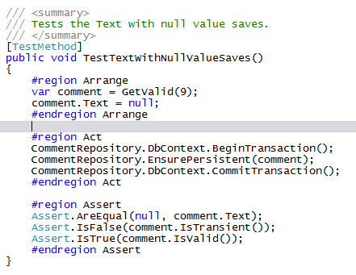
Sample of a simple unit test

Slide 6
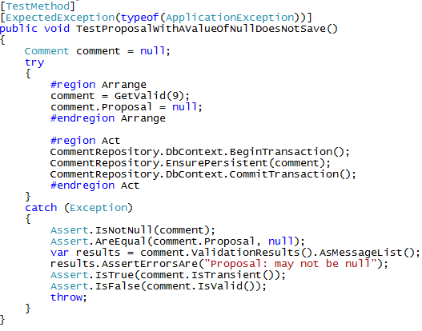
Sample of an Expected Exception

Slide 7
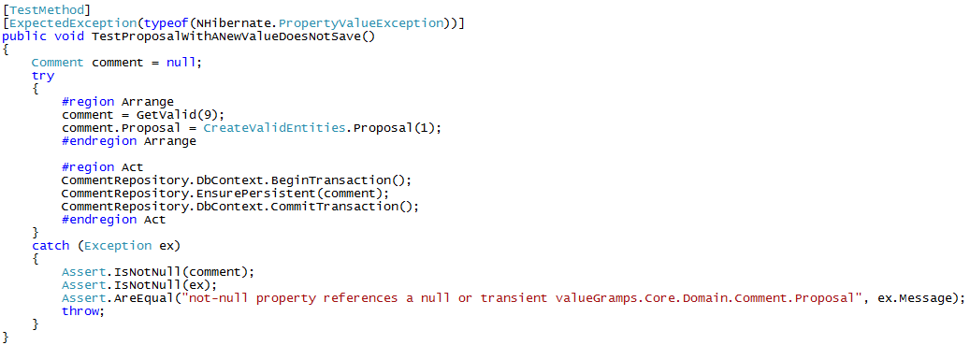
Another Expected Exception

Slide 8
Types Of Unit Tests

Slide 9
Types Of Unit Tests
Repository Tests
Controller Tests
Interface Tests

Slide 10
Repository Tests
Test Database actions
Done on an in memory SQL Lite database created from the mapping file.
This is done by using UCDArch’s base class in testing “: FluentRepositoryTestBase<TMap> where T : DomainObjectWithTypedId<IdT> ”

Slide 11
Types of Repository Tests
CRUD Tests (if you use my base class and resharper template, these are done with minimal coding)
Invalid Boundary Tests
Too Long, Too Short
Not Null
Required
Exceptions

Slide 12
Types of Repository Tests Cont.
Valid Boundary Tests
Maximum and minimum length
Null, empty, or spaces only when allowed
Constructor Tests
Fluent Mapping Tests
Reflection Tests
Ensure code coverage of tests

Slide 13
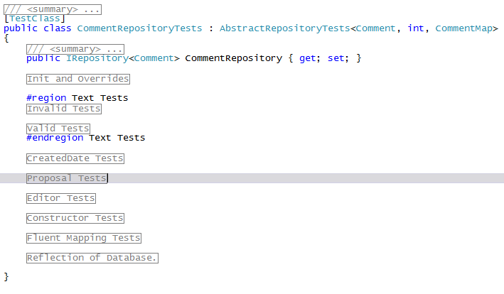
Example of Repository Test layout

Slide 14
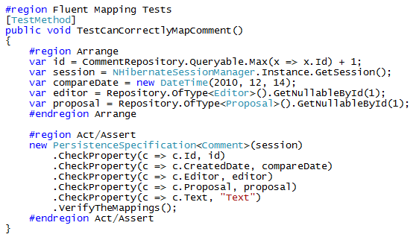
Fluent Mapping Example

Slide 15
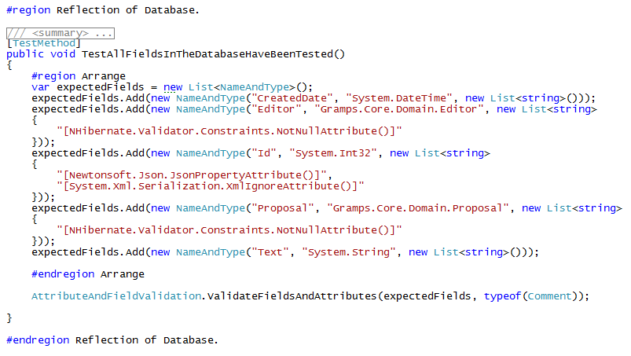
Reflection of the Database Example
Notes:
These tests both check that the attributes are as expected and that the public methods have not been added or removed.

Slide 16
Controller Tests
Mapping Tests
Boundary Tests of all public methods
Reflection Tests

Slide 17
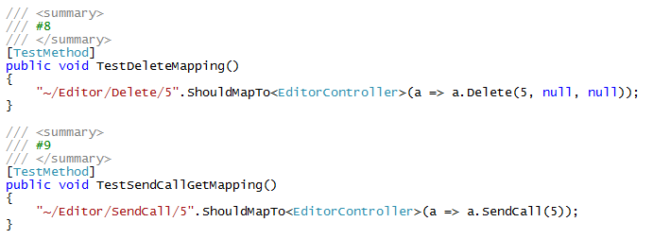
Mapping Tests

Slide 18
Boundary Tests of all public methods
Sorry, no auto generated tests (But I do have helpers)
Setup the data (Fake)
Mock methods
Repository, Interfaced methods
Assert that they were or were not called
Check that the parameters passed were what was expected
Check that a view was rendered or was redirected
Check Controller Message and ModelState

Slide 19
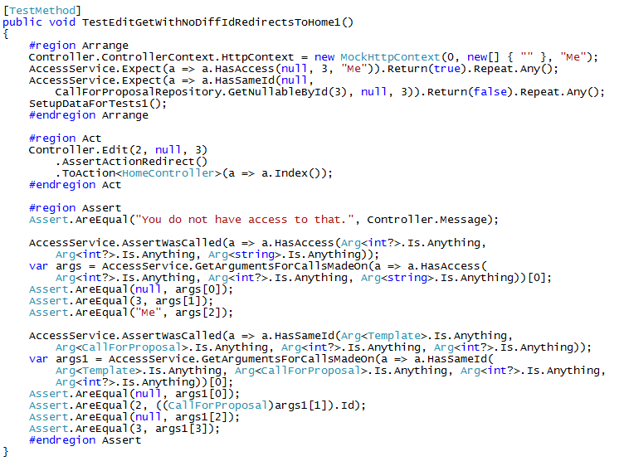
Example Of A Controller Method Test

Slide 20
Reflection Tests
Tests existence of attributes which are not called in the unit tests
Uses reflection
Ensures code coverage
I only add the method to this section once I have done Mapping and Boundary Tests
Two Main Areas
Controller Class
Controller Methods

Slide 21
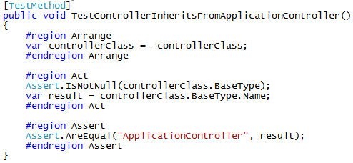
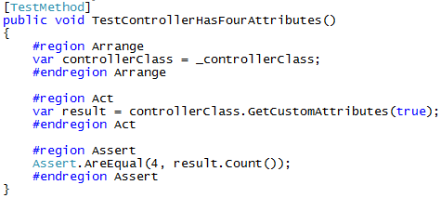
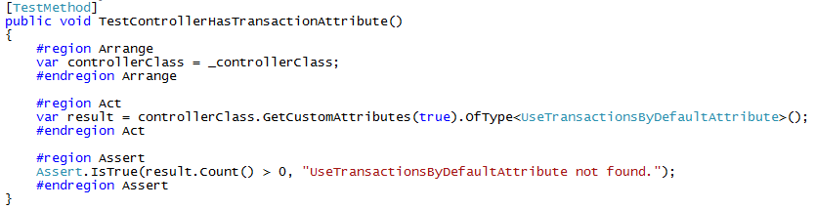
Controller Class Tests

Slide 22
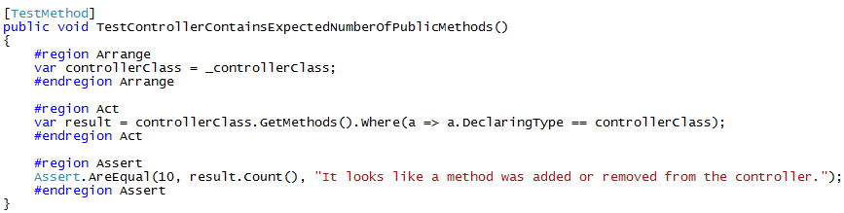
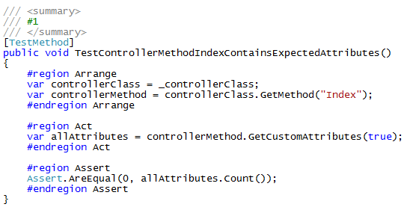
Controller Method Tests

Slide 23
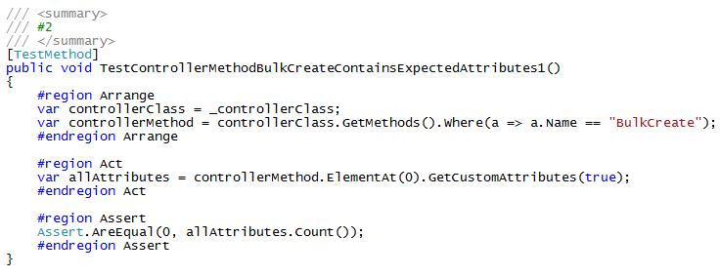
Controller Method Tests Cont.

Slide 24
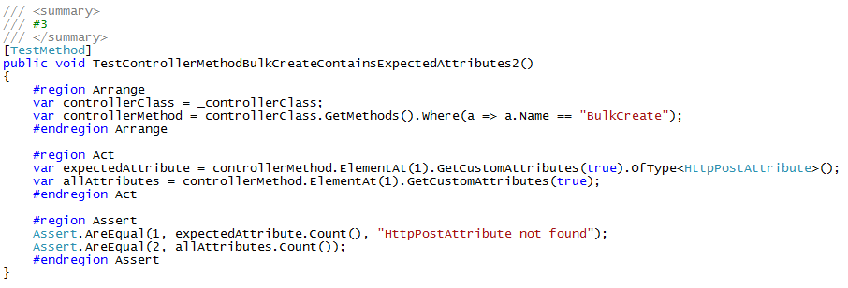
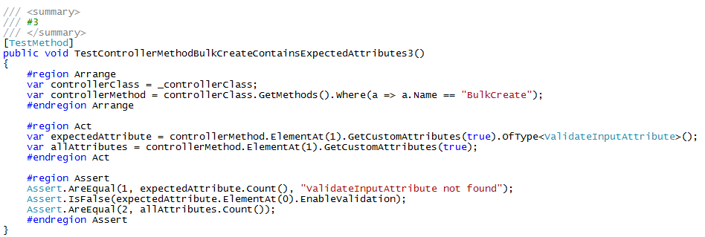
Controller Method Tests Cont.

Slide 25
Interface Tests
Sometimes these need to be run within the structure of a Controller test
Check that expected parameters are passed
Check that any actions or return values are what is expected
Even if you don’t write tests for your interfaces, you just have one place to review the logic.

Slide 26
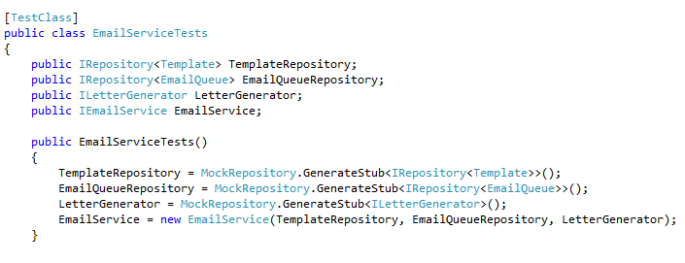
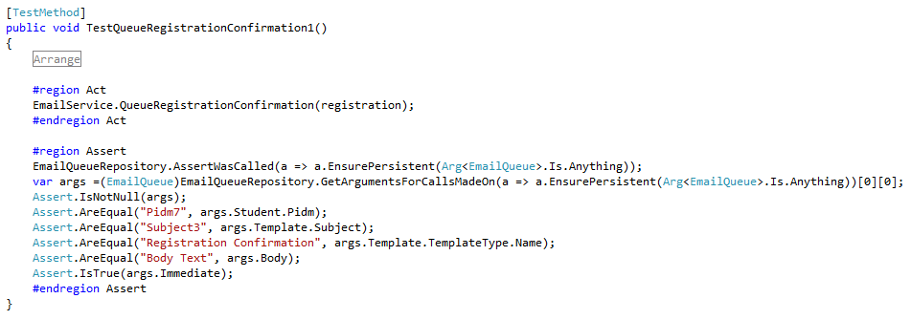
Interface Tests Example

Slide 27
File Structure Of Unit Tests

Slide 28
File Structure Of Unit Tests
Project.Tests
ControllerTests
Core
InterfaceTests
MiscTests
RepositoryTests
ViewModelTests

Slide 29
ControllerTests
Controller1Tests (Partial Classes)
Controller1TestsInit.cs
Controller1TestsMapping.cs
Controller1TestsPart01.cs
Controller1TestsPart02.cs
Controller1TestsReflection.cs
Controller2Tests.cs

Slide 30
Core
Extensions
AssertExtensions.cs
RouteTestingExtensions.cs
StringExtensions.cs
Helpers
AttributeAndFieldValidation.cs
ControllerRecordFakes.cs
CreateValidEntities.cs
NameAndType.cs
SpecificGuid.cs
AbstractRepositoryTests.cs (until moved to UCDArch)

Slide 31
Interface Tests
<InterfaceName>Tests.cs

Slide 32
Misc Tests
Test that Role Attributes work as expected.
Other Tests that don’t really fall in other categories

Slide 33
RepositoryTests
SmallRepository1Tests.cs
LargeRepository2Tests (partial Classes)
LargeRepository2TestsInit.cs
LargeRepository2TestsConstructor.cs
LargeRepository2TestsFluentMapping.cs
LargeRepository2TestsPart01.cs
LargeRepository2TestsPart02.cs
LargeRepository2TestsReflection.cs

Slide 34
ViewModel Tests
I’d suggest only having ViewModel Tests if the logic is particularly convoluted.
These tests can usually be integrated into the controller tests

Slide 35
Helper Methods

Slide 36
Helper Methods
UCDArch.Testing. More may be moved there
ControllerRecordFakes.cs
FakeHttpPostedFileBase.cs
FakeIdentityAndFiles.cs
AttributeAndFieldValidation.cs
CreateValidEntities.cs
NameAndType.cs
SpecificGuid.cs

Slide 37
Resharper Templates

Slide 38
Resharper Templates
Generate Files or Code, prompting values to be replaced
My templates start with Jason so I can find them easily. If you use mine, feel free to rename or edit them.
Two main Types of Templates
FileTemplates
LiveTemplates

Slide 39
File Templates
JasonControllerTest
Creates a simple file with examples for Controller tests
JasonRepositoryTest
Creates a repository test file using the Abstract base class
Initializes data, does CRUD tests.

Slide 40
Live Templates
JasonBoolTests
Creates two tests, code for reflection in comment
JasonCheckRequire
Single Test with expected Exception
JasonDateTests
Three Tests, past current, future. No Nullable. Code for Reflection
Evict
Code to evict entity.
JasonGetArguments
Code to get the arguments for Repository Entity EnsurePersistent. Needs tweeking.
JasonStringTests / JasonStringTestsLengthOnly
A bunch of string tests. Needs a little tweeking sometimes. Code for Reflection

Slide 41
Summary
This is the basic structure for Unit Tests that I have been using.
It continues to evolve.
If you come up with other ways to get better coverage, less fragile tests, or other improvements please share.
Notes:
Summarize presentation content by restating the important points from the lessons.
What do you want the audience to remember when they leave your presentation?
Save your presentation to a video for easy distribution (To create a video, click the File tab, and then click Share. Under File Types, click Create a Video.)

Slide 42
Resources
The Art of Unit Testing http://artofunittesting.com/
This slide deck and related resources: https://github.com/jSylvestre/ResharperTemplates

Slide 43
Questions?

